Slide 1
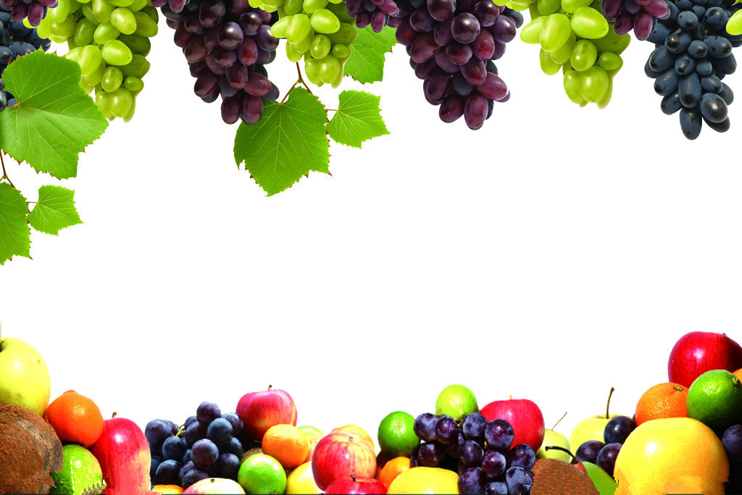
Unit 5 Do you like pears?
A Let’s learn
茶阳镇中心小学 范婷

Slide 2
Free talk (1)
A:Good morning.
B:Good morning.
A: Where are you from?
B:I’m from… Where are you from?
A: I’m from…
B:Nice to meet you.
A:Nice to meet you,too.

Slide 3
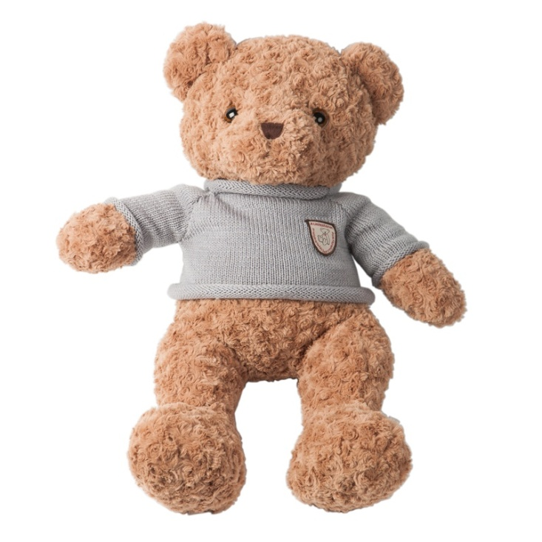
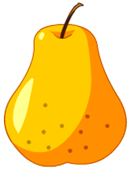
pear
bear

Slide 4
pear
pears

Slide 5
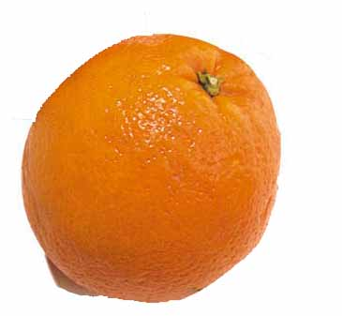
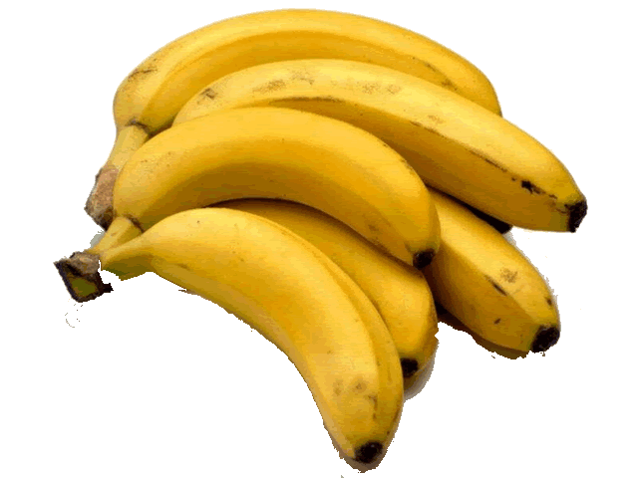
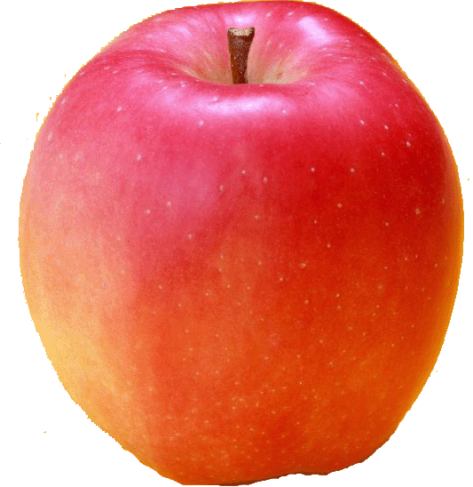
Memory challenge
（记忆力大挑战）

Slide 6
Free talk (2)
A:Hello,XX.
B:Hello,XX.
A:I like …, do you like …?
B:Yes,Ido./ No, I don’t. I like…

Slide 7
Free talk (3)
A:Look,what’s that?
B:It’s a/an…
A: What colour is it?
B:It’s…
A:I like.... Do you like…?
B:Yes,I do./ No,I don’t. I like…
A:Ok.Let’s have some pears and…
B:Great.

Slide 8
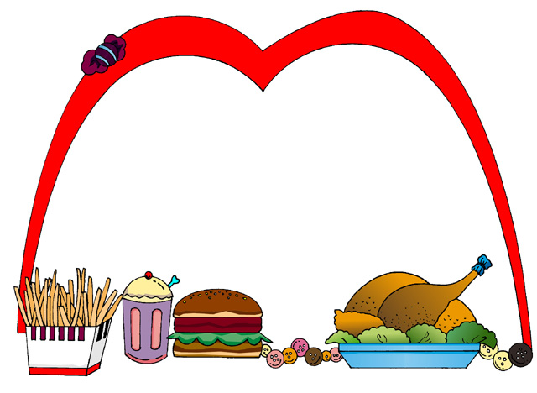
Homework:
1.询问并记录家人喜欢的水果。
2. 每个单词抄写一行，一行六个。

