Slide 1

Unit 5
My English Learning Experience

Slide 2




What trouble do you have in English learning?
I have trouble with listening./……
Trouble

Slide 3

Nancy

Slide 4
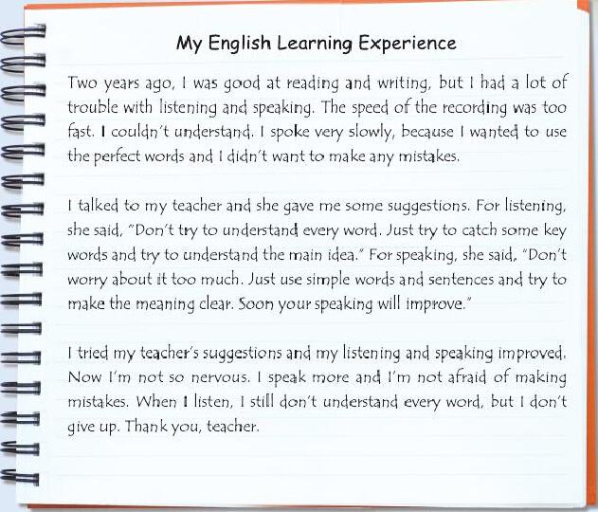
Paragraph 1
Paragraph 2
Paragraph 3

Slide 5
Exercise 1
Read Nancy’s diary and match the paragraphs (1-3) with the main idea(a-c).
Paragraph 1
Paragraph 2
Paragraph 3
a) Suggestions from Nancy’s teacher
b) Nancy’s English learning now.
c) Nancy’s trouble in learning English two years ago.

Slide 6
Exercise 2
Read again and complete the table.
Speaking
Two years ago | Trouble1: Listening 1 the speed of the recording was too fast 2 couldn’t understand | Trouble2:
Suggestions |  | 1 use simple words and sentences 2 try to make the meaning clear
Now | 1 still don’t understand every word 2 don’t give up
1 spoke very slowly
1 don’t try to understand every word
2 catch some key words
3 understand the main idea
1 not so nervous
2 speak more
3 not afraid of making mistakes

Slide 7
Exercise 3
Read two passages and underline the sentences about English learning ways.

Slide 8


征文
同学们，在你读完Nancy的文章后，是否也想动笔写下自己英语学习的经历呢？如果你也想，就请你以My English Learning Experience为题，和大家分享你的英语学习经历吧！

Slide 9
Exercise 4
Complete the table.
至少补全表格第一列，写出一个英语学习方面的困难
ten
Reading
_____ years ago | Trouble1: | Trouble 2:
Suggestions / English learning ways
Now
1don’t like reading
2 read slowly
1 choose interesting passages
2 read every day
3 don’t look up every word
1 read quickly
2 can guess new
words’ meaning

Slide 10
Ten years ago | Trouble1: Reading 1 don’t like reading 2 read slowly
Ten years ago, I had a lot of trouble with reading. I didn’t like reading. I read very slowly because I wanted to understand every word.

Slide 11
Suggestions / English learning ways | 1 choose interesting passages 2 read every day 3 don’t look up every word
I talked to my teacher and she gave me some useful suggestions. “You can choose interesting passages and read every day. You shouldn’t look up every new word in it.”

Slide 12
Now | 1 read quickly 2 can guess new words’ meaning
I tried my teacher’s suggestions and my reading improved. Now I can read quickly and guess new words’ meaning.

Slide 13
Writing
Ten years ago, I had a lot of trouble with reading. I didn’t like reading. I read very slowly because I wanted to understand every word.
I talked to my teacher and she gave me some useful suggestions. “You can choose interesting passages and read every day. You shouldn’t look up every new word in it.”
I tried my teacher’s suggestions and my reading improved. Now I can read quickly and guess new words’ meaning.

Slide 14
Thank you!

